Slide 1
CSC6032 – Advanced Operating Systems
P2P Systems
Prof. Yeh-Ching Chung
School of Data Science
Chinese University of Hong Kong, Shenzhen

Slide 2
Outline
Introduction
Technical Overview
RIOT in Action

Slide 3
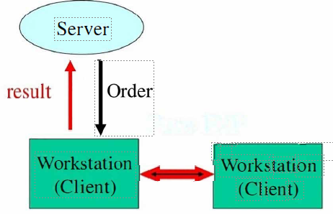
Client-Server Model
Assumption
  Workstation is powerless that it can not do any task
  Only user (Operator) can control the workstation
Pure P2P

Slide 4
Client/Server Limitations
Scalability is hard to achieve
Presents a single point of failure
Requires administration
Unused resources at the network edge
P2P systems try to address these limitations

Slide 5
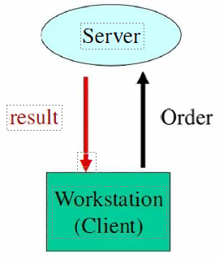
P2P Model
Assumption
  Workstation is powerful enough to do some tasks
  Other workstation and server can remote-control the workstation

Slide 6
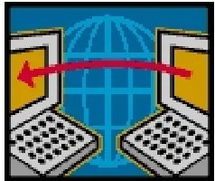
P2P Network
P2P network is a technology that enables two or more peers to collaborate spontaneously in a network of equal peers by using appropriate information and communication systems without the necessity for central coordination.
  File/information/resource sharing
  Equal peers
  Decentralization

Slide 7
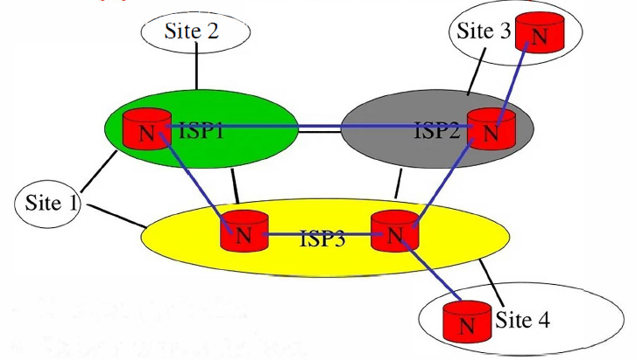
Application Layer Overlay
P2P systems are overlay networks without central control
  One per application
  Nodes are decentralized

Slide 8
Client-Server & P2P Network
A simple distinction
  Client-server
    Computers perform asymmetric functions
  Peers-to-Peer (P2P)
    Computers perform symmetric functions
Different architectures offer different benefits
Pure P2P networks are rare
  Most P2P networks rely on centralized server for some functions

Slide 9
P2P Network Features
Clients are also servers and routers
  Nodes contribute content, storage, memory, CPU
Nodes are autonomous (no administrative authority)
Network is dynamic
  Nodes enter and leave the network "frequently“
Nodes collaborate directly with each other (not through well-known servers)
Nodes have widely varying capabilities

Slide 10
P2P Computing Features
P2P computing is the sharing of computer resources and services by direct exchange between systems.
These resources and services include the exchange of information, processing cycles, cache storage, and disk storage for files.
P2P computing takes advantage of existing computing power, computer storage and networking connectivity, allowing users to leverage their collective power to the 'benefit’ of all.

Slide 11
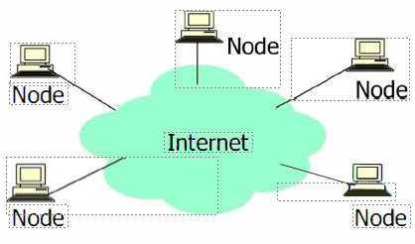
P2P Architecture
All nodes are both clients and servers
Provide and consume data
  Any node can initiate a connection
  No centralized data source
  The ultimate fonn of democracy on the Internet
  The ultimate threat to copy-right protection on the Internet

Slide 12
P2P Network Characteristics
Clients are also servers and routers
  Nodes contribute content, storage, memory, CPU
Nodes are autonomous (no administrative authority)
Network is dynamic : nodes enter and leave the network frequently
Nodes collaborate client with each other (not through well-known servers)
Nodes have widely varying capabilities

Slide 13
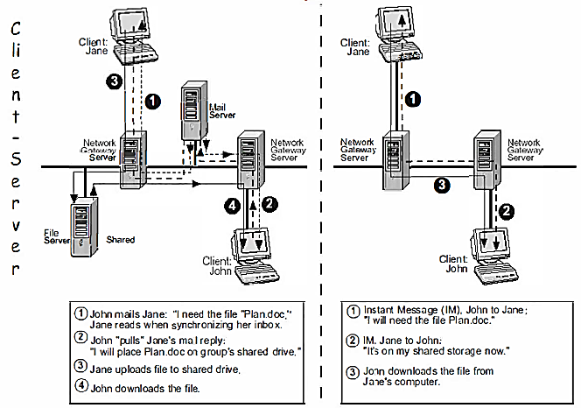
Client Server vs. P2P Example

Slide 14
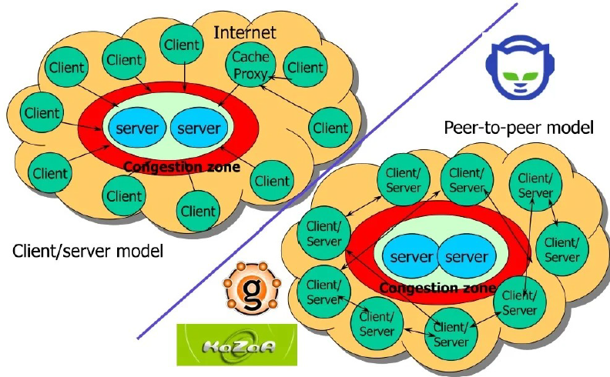
Large Scale Data Sharing of P2P

Slide 15


P2P History: 1969 - 1995
1969 -1995: the origins
  CPU In the beginning, all nodes in Arpanet/Internet were peers
  Every node was capable to
perform routing
  accept ftp connections
  accept telnet connections
(locate machines)
(file sharing)
(distributed computation)
'50 `60 '70
'80 `90
1994
1992 10k Web Servers
50 Web Servers
1971
email appears
1969 Arpanet
1957 1962
Sputnik Arpa
1990 WWW proposed

Slide 16
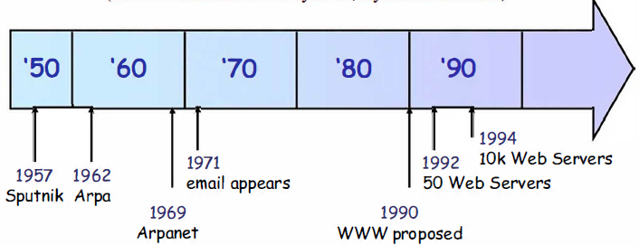
P2P History: 1995 - 1999
1995 - 1999: the Internet explosion
  The original "state of grace" was lost
  Current Internet is organized hierarchically (client/server)
    Relatively few servers provide services
    Client machines are second-class Internet citizens(cut off from the DNS system, dynamic address)

Slide 17
P2P History: 1999 - Today
1999 - today: the advent of Napster
  Jan 1999: the first version of Napster is released by Shawn Fanning, student at Northeastern University
  Jul 1999: Napster, Inc. founded
In short time, Napster gains an enormous success, enabling millions of end-users to establish a file­ sharing network for the exchange of music files
  Jan 2000: Napster unique users> 1.000.000
    Nov 2000: Napster unique users > 23.000.000
    Feb 2001: Napster unique users> 50.000.000

Slide 18
P2P Benefits
Efficient use of resources
  Unused bandwidth, storage, processing power at the edge of the network
Scalability
  Since every peer is alike, it is possible to add more peers to the system and scale
to larger networks
  Consumers of resources also donate resources
  Aggregate resources grow naturally with utilization
Reliability
  Replicas
  Geographic distribution
  No single point of failure
    E.g., the Internet and the Web do not have a central point of failure.
    Most internet and web services use the client-server model (e.g. HTTP), so a specific service does have a central point of failure
Ease of administration
  Nodes self organize
  No need to deploy servers to satisfy demand - confer (compare, c.f.) scalability
  Built-in fault tolerance, replication, and load balancing

Slide 19

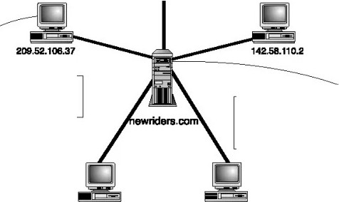
The traditional network architecture
6心．111.90
Client巾啊心谴i国眼叹
妇dfJQ田NN阑山b呻喊．一
J袖＂!Ningie“幻”“幻星巾平』1111忙'·酗冒W”
妇叩rm畔”J”'m·
4血订叩commanda响田谪｀鼠鲍”“
-n议觥而ng-叩8而叩��there-麟“ice
·Send司1曰尸归育且h.... oll归叩叩如1臼叩
216.110.42.176
84.40.111心

Slide 20
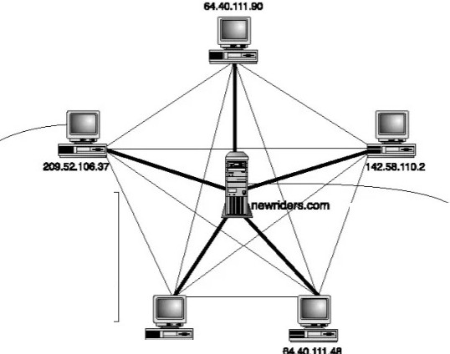

hybrid P2P network architecture
A
口叩印叩心1岫蛔
归血崎呱如叩枷1心一一心妇_,
811111.-.V心1IIIIll心幻．一1DInd·叩配0-
瘤山叫归衄1ng pears'
屯n 叩血
·卯蛌八．一
叭一”g加咖叫切
.n氧息h句u-mm．一斗1恤幽`.lllolpeas
咖归山I酬掣胃心
·妇”““mm舶山幻叩窜P”“幻一·叩氧生IIMCI
．田
．＂儿汕-.i,.叩”“.ma-1ara“心血·叩血cpeer
．几汕OIIIIIII匐山的m氓面p”“一．＂呻
.n md-们”“”“°
.”“”“巾叩on..1D1”m“”“言I-
，畸哑响阶U星虹1d
啊
218.110.心．17e

Slide 21
P2P must be disruptive…
Peer-to-peer (p2p): third generation of the Internet
1st generation: "raw" Internet
2nd generation: the Web
3rd generation: making new services to users cheaply and quickly by making use of their PCs as active participants in computing processes
P2P doing this in "disruptive" ways

Slide 22



Bandwidth and Storage Growth
Moore's Law
． Network, Storage and Computers Network speed doubles every 9 months Storage size doubles every 12 months
＞
Computer speed doubles every 18 months
．1986 to 2000
Computers : X 500 Storage : X 16,000
Networks: X 340,000
2001 to 2010
Computers : X 60 Storage : X 500 Networks : X 4000
芒臾
气兰盂mo
飞—
踏器监ind)
j-S P O
』旦
．
」中
d i , ao. u;e g 0
芒兰需兰，DaiaS泣a
吐－ m～r丘_,.^r8m心
g它
。
亡中
d
，一
₁`,"'
2 3
�
- 5
Numb忒0，八Yoa,s
Graphf,-om Scientific American (Jan 2001) by Cleo Villett,
source Vin.eelKhos/an, Kleiner; Caiifield and Perkins.

Slide 23
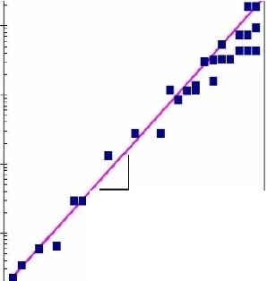
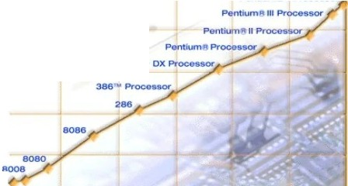
Moore's Law
In 1965� Gordon Moore predicted小at由enumb釭of四an3stQrs由atcanbe
integrated on a die would dollble ew切只8tol4moo邮
  i.e龟� grow e.xponen血且yw汕血e
Am呻g啦on叩－million tr邸sisto.c／啦pba兀虹叩沁OSSedm山eI98，0“s-
2300 tr皿sistors》l MHzclo心0血4004)- 1911
42 Million�2沺飞吐(IntdP外2OOI
140 Million transistor佃陕85OO)
transistors
1E+-08
•
1.E+07
Pentlvmtt4P心essor
100,000,000
1
S k ) S ! S U e .J
MOORj:'S LAW
一
10,000,000
E
书
6
488八
一 』
1,000,000
1
O J aq E n N
E
句
5
100,000
2x/1.5year
10,000
1
E
书
4
4004
1000
2000
Intel processors
1970
1975
1980
1985 1990 1995
1.E+03
1970 1975 1980 1985 1990 1995 2000
Year
Source: Intel web page (www.intel.com)

Slide 24
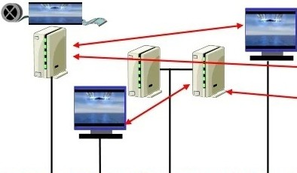
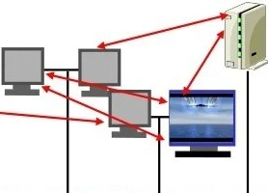
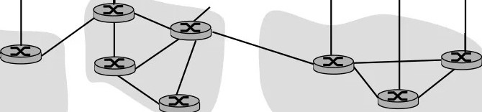
Peer-peer networking
Focus at the a匹lication level
＿＿＿＿＿＿＿＿＿＿＿＿，一一一一一一一一一一l一一一·------

Slide 25
Peer-peer networking
Focus at the a匹lication level
＿＿＿＿＿＿＿＿＿＿＿＿，一一一一一一一一一一l一一一·------

Slide 26
How it works

Slide 27

Classification of the P2P Systems
Three main categories of systems
Centralized systems: peer connects to server which coordinates and manages communication. e.g. SETI@home
Brokered systems: peers connect to a server to discover
other peers, but then manage the communication themselves (e.g. Napster). This is also called Brokered P2P.
Decentralized systems: peers run independently with no
central services. Discovery is decentralized and communication takes place between the peers. e.g. Gnutella, Freenet
True P2P

Slide 28
What P2P is good for?
Community Web network
  Any group with specific common interests, including a family or hobbyists, can use lists and a Web site to create their own intranet.
Search engines
  Fresh, up-to-date information can be found by searching directly across the space where the desired item is likely to reside
Collaborative development
  The scope can range from developing software products to composing a document to applications like rendering graphics.

Slide 29
P2P Application Areas
Communication
  AOL Instant Messenger
  ICQ
Remote Collaboration (Shared File Editing, Audio-video Conferencing)
  Jabber
  Shared whitebo釭d
Multiplayer Games
  Unreal Tournament, DOOM
Streaming (Application-level Multicast)
  Narada
  Yoid
  NlCE, CAN-Multicast, Scribe
Distributed Computing
  SETI@home
File Sharing
  Napster
  Gnutella, Freenet, LimeWire
  KazaA, Morpheus
Ad-hoc networks

Slide 30
File-sharing vs. Stream．ing
File-sharing
  Download the entire file first, then use it
  Small files (few Mbytes) □ short download time
  A file is stored by one peer □one connection
  No timing constraints
Streaming
  Consume (playback) as you download
  Large files (few Gbytes) □ long download time
  A file is stored by multiple peers□several connections
  Timing is crucial

Slide 31
Example P2P Applications
The following areas are detailed in the following
slides:
—Instant Messaging
  File exchange
  Collaboration
  MIPS sharing
  Lookup services
  Mobile ad hoc communication
  Content Distribution
  Middleware

Slide 32
Instant Messaging
A convenient way of communicating with a small驴·oup of selected people (e.g., friends,
family members, etc.)
Usually, a central server is used to store user profiles and to have a list of registered users
While communication takes place between the peers, searching for other people is done using the server
One of the reasons why a server is needed is the ability to send messages to other
persons (i.e., peers)
If the target peer is not online, the system has to store the message until the target
peers becomes online again
  This would be, of course, also possible with a server-less P2P system, but the price would be an increased complexity and a certain probability of messages getting lost
  Examples for such systems are:
    Napster
    ICQ
    threedegrees
    Jabber

Slide 33




File exchange
� BitTorrentN
． There is little dispute about the usefulness of P2P file sharing
．
applications
Ir喝咖
While downloading files is always done directly between peers (or via a proxy peer to enable anonymity), the way of searching for these files differs in many P2P applications
Some use central servers (e.g., Napster) while others send search requests
directly to other peers (e.g.,
．
邑网炬飘霎盆＠
．
Gnutella, Freenet, & FastTrack)
艾
．． 肛
． ．．
, ..: ' ,f“l
� “
, ; · , ' ' , . , ' , . . . , ' , . . . .
�
勹ster勹
"-.···············+-···
匕｀ ｀°...归幻血；议
Jf
．
．．』
一 一 二 ．．
、、
f
4
”

Slide 34
Collaboration
This is not a typical example for the usefulness of P2P technology
It is about having people having the same view or different views on shared
information
This would typically call for a server storing this information
This way, the information is available to all members without the necessity of having the information provider or contributor online or the data distributed to all other participants
But there are use cases where P2P technology comes in mobile phones
One example could be ad hoc collaboration of devices in an environment where no connection to a server exist
  E.g., people are meeting in a place where no connection to the Internet is available
In this scenario, people would communicate (and collaborate) in a server-less P2Pmanner
One perfect example for this use case is Groove
  It uses a server to store shared information but is also able to provide collaboration services without the existence of such a server

Slide 35
从IPS sharing
．
．
One of the major assets of the Internet is its combined processing power
- which is currently vastly under-ut山zed
To utilize these resources, user are asked to download and install progrruns that are able
to do a small part of a complex computation while the computer is not used
- E.g., while the screen saver is running
．
Examples for MIPS sharing systems are:
Seti@HOME
Genome@HOME
In this category of P2P applications, the social aspect is very important
Were it not for the search for extraterrestrial life or cancer research, not many people would be willing to share their processing power
Hence, there must an incentive for users to share computer resources, be it money, public well­
fare or the like
Furthermore, this type of P2P application can only function with a central server that is coordinating the distribution of computation tasks and the validation of the results
．．
．

Slide 36
．
Lookup services
Most of the scientific P2P research is done in the area of lookup services
This is not very surprising because searching is one of the major challenges in P2P networks
Most of the P2P systems that are optimized for lookup services are using distributed hashtables (DHT)
  which are capable of searching with logarithmic complexity
The drawback of most of these systems is the fact that they扣·e only able to search for numbers
  In case they are searching for strings, they are searching for numerical representations of these strings
Examples for such systems are:
  PAST
  Chord
  P-Grid

Slide 37
从obile ad hoc communication
Ad hoc communication, especially when it is done among mobile devices
  I.e., the devices are connected directly via a wireless communication link
  This is the best example for the usefulness of the P2P paradigm
Devices connect to each other in an ad hoc manner
Due to the limited communication capabilities of mobile devices (such as mobile phones or handheld devices), frequent disconnections may occur
When mobile devices are connected together, there is no guarantee that a central server may be available
Hence, ad hoc mobile communication must not rely on the existence of such a server
All these characteristics also apply to the P2P paradigm
There exists only a small number of P2P systems that can be used in conjunction with small devices:
  GnuNet
  JXME (JXTA for J2ME - the Java 2 Mobile Environment)

Slide 38
Content Distribution
P2P can also be used for the distribution of information or files
- sometimes called ESD - electronic software distribution
Instead of having a central source that emits files to the destination computers directly, a P2P network may disseminate files while avoiding hot spots in the network
The load (i.e., the bandwidth, CPU power, throughput, etc.) is distributed over the whole network
This concept is successfully used, for example, by Intel where software
is distributed to international branches in a P2P style
This system can be compared to a push system
The advantage is that there is no need for a fixed environment of push server and proxies

Slide 39
从iddleware
The most demanding use case for a P2P system is its use as a
血ddleware platform. P2P middleware systems provide services such as distributed search or peer discovery to higher-level applications
Different kind of P2P systems have a limited set of application domains
Depending on the structure (or topology) of the P2P network, various use cases may become feasible or impossible
If a P2P system is needed as a middleware, the use case turns the balance which P2P system best fits the requirements
  Only a few P2P systems may be used as a P2P middleware platform:
    JXTA
    Omnix

Slide 40
Port Numbers Used by Various P2P
Applications
P2P application Bittorrent edonkey Gnutella MOIpheus
Kazaa EMule
WinMx Lirnew订e Napster BearShare
Port
default 6881-6889 TCP/UDP
fully configurable default 4662/TCP. 5737/UDP default 6346/6347 TCP/UDP
default 6346/6347 TCP/UDP default 1214 TCP/UDP
fully configtirable default 4662/TCP 4672/UDP
fully configtu-able default 6699/TCP 6257/lJDP default 6346/6347 TCP/UDP
client default 6699 TCP alternate 6600-6699 TCP default 6346 TCP/UDP

Slide 41
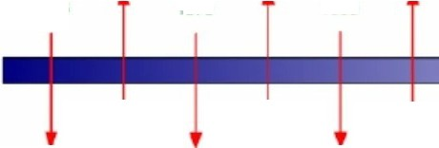
Timeline of P2P networking evolution
P2P ne切()11<Ing atImc飞attention due to Naps记r; several n义works I.au广ched to date. aswdl心the
JXTAand
Jabber
叩r寸ardi炽仆ion
initiati啦．
Conce以ofan AS is inlrod心d for n引WOf1< lay百 routing.
W叩relea函 by CERN;
Int的d的as a
P2P!pl)lic.lli0!'1.
ARPANET
prog尺tm沁CS
completlon.
TCP/IP protocol sucteis
如dardised.
ICQ is launched
1966
'976
1983
1990
1994
1999
1969
19叨
1966
1992
1996
2000
ARPANET | 白rs1formal use | ARPANET | ARPANET | lnl.ernet
program | of TCP. Applied | officially忒opts | Officially | 心mmercialis的．
Napst“is launched.
Ommi达ioned by US DoD.
to lntornetworkJng PRN七Ta心
ARPANET.
the心e of TCP/ IP
disbanded: lo be replaced by NSFNET.
shift to c值enIJ
GO八，er
networ1e1n9.

Slide 42
P2P Technical Challenges
Peer identification
Routing protocols
Network topologies
Peer discovery
Communication/coordination protocols
Quality of service
  Security
  Fine-grained resource management

Slide 43
Q & A

